Slide 1




HackOrbit 2025
Team Debugs

Slide 2

Sustainability
Empowering Individuals to Track and Reduce their Carbon Footprint!!
Design and develop a user-centric Carbon Footprint Calculator App that empowers individuals to measure, understand, and reduce their environmental impact. This app should go beyond simply calculating emissions—it should promote behavioral change by delivering personalized tips, visualizing eco-goals, and fostering a community-driven approach to sustainability.

Slide 3
Carbon Mitra
Your smart and personalised sustainability companion
This App is designed to help users to monitor their daily activities and estimate their carbon emissions , it also provides tips to reduce carbon footprint and visual reports to track the progress over time.
• A smart, gamified carbon footprint calculator designed to guide, motivate, and reward eco-conscious living.
• Core Features:- Automated Activity Tracking - Integrates with calendars, GPS, ride-hailing, and e-commerce apps to estimate emissions passively. - AI-powered lifestyle pattern recognition to reduce manual input.
• Personal Climate Assistant - Region-aware nudges Suggests local alternatives for food, transit, and shopping.
• Eco-Habit Gamification - Earn points, badges, and streaks for low-carbon actions. - Join social challenges with friends, colleges, and neighborhoods.
• Carbon Diary Visualization - Color-coded timeline of emission levels, which Highlights “high-carbon” days with AI-generated improvement tips.
.

Slide 4
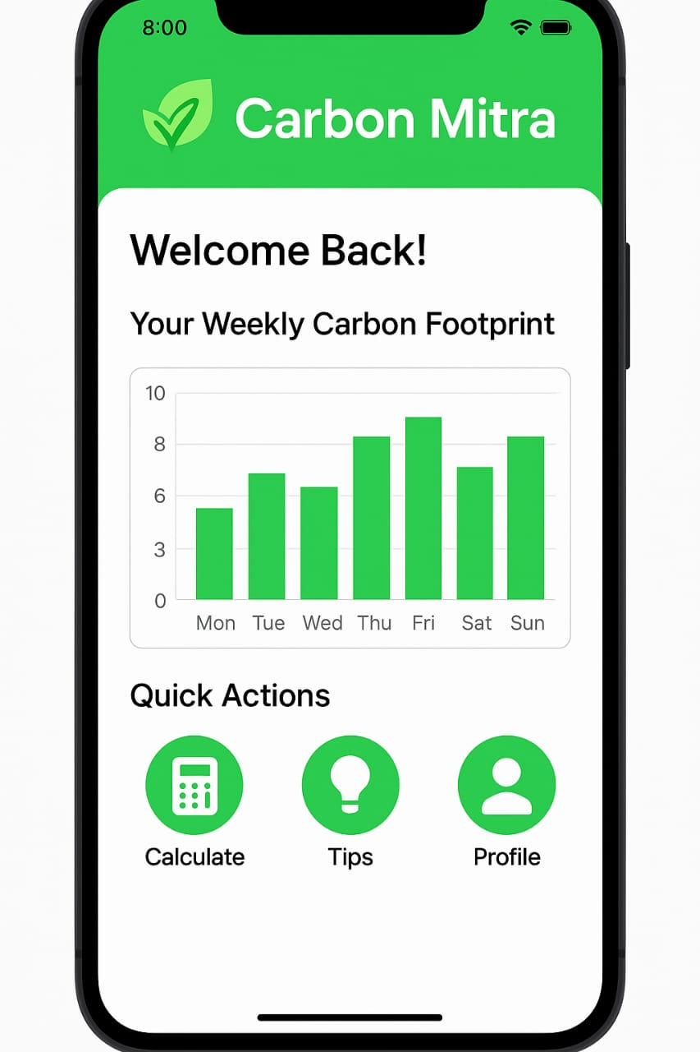

Slide 5
FLOWCHART / DIAGRAM
1. Launch App - The user opens the Carbon Mitra app on their device.
2. User Registration / LoginNew users create an account using email, phone number.Returning users log in to access their data and progress.
3. Home Dashboard After login, users land on the Dashboard, the central hub of the app. It gives an overview of the user’s:Carbon footprint data , Total points earned Suggested actions Access to all other app modules.
4. Carbon Calculator Users enter details about their daily habits, such as, Transport (car, bus, bike, etc.) Electricity and water usage, Food consumption (veg, non-veg, local produce) Shopping habits and the calculator estimates the carbon footprint based on input.
1

Slide 6
FEATURES AND NOVELTY
Features
• Smart Carbon Tracking- Passive activity tracking using GPS, calendar, and receipts.- AI estimation of daily emissions based on lifestyle data.
• Personal Climate Coach- Localized sustainability prompts (e.g. “Switch to walking—Delhi’s air quality is poor today.”)- Personalized eco-goals tailored to the user's habits and environment.
• Visual Emission Diary- Color-coded timeline showing good vs high-carbon days. Insights and suggestions from AI to improve carbon scores over time.
• Gamified Experience- Earn points and badges for sustainable behavior.- Eco-streaks and community challenges that promote friendly competition.
• Reward Ecosystem- Redeem points for green products, donations, tree-planting credits.- Partner network of sustainable brands and services.
• Social Sustainability- Share progress with friends or form “green squads”.- Neighborhood and college leaderboards to build momentum.
•. Offline & Low-Data Mode- Works seamlessly in low-connectivity regions.- Syncs later to keep user experience smooth and inclusive.
Novelty
• Personalized Eco-Scorecard
• Eco Tips Based on Local Data
• Passive Tracking-Most calculators require manual inputs this one integrates real-world data smartly.
• Localization-Tailors recommendations based on city, air quality, transport systems, regional habits.
|

Slide 7
DRAWBACK AND SHOWSTOPPERS

Slide 8
Team Debugs
Kumkum Chauhan - Email id- 2024149619.kumkum@ug.sharda.ac.in
Pavni Singh Email id – 2024205922.pavni@ug.sharda.ac.in
Contact no. 9520588400 , 9068746728

Slide 9
Thank you

